Slide 1

FOOD-SENSEI – Your AI Nutrition Coach
An AI-powered food analyzer, critic, finder and myth buster
Powered by Gemini APIs & Crew AI | Built with Flask
by Polar Devs

Slide 2

What is FOOD-SENSEI?
AI-powered nutrition coach that analyzes your food.
Detects packaged vs. unpackaged meals using images.
Estimates nutrition, gives health advice, and busts myths.
Backed by Gemini AI, Crew AI agents, and smart scraping.

Slide 3
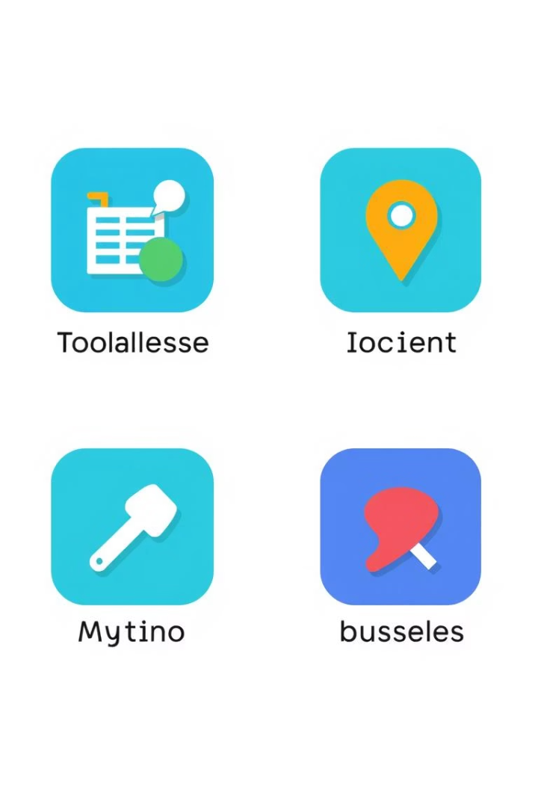

Key Features Overview
Smart Food Analyzer
Identify nutrition and health tags from food images.
Healthy Nearby Finder
Locate healthy options around you with live search.
Food Myth Buster
Ask questions; AI debunks myths with science.
Each task is modular and can be demoed independently.

Slide 4

Task 1 – Smart Food Analyzer
Agents tag health flags
Fetch or estimate nutrition details
Gemini detects packaging status
Upload a food photo
Examples: “Too much sugar,” “Great choice!”

Slide 5
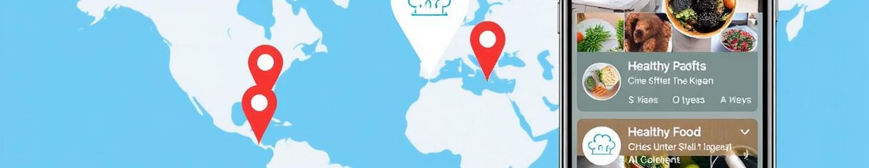
Task 2 – Healthy Nearby Finder
Enter your location
Gemini and search find healthy spots
Receive smart alternatives
Easy input for precise results
Live data powers accurate nearby options
Example: “No salad? Try half sandwich from Café X.”

Slide 6
Task 3 – Food Myth Buster
User asks food myth questions
Gemini delivers accurate verdicts
Includes practical advice
Optional image input for better context
Simple input for complex queries
✅ Truth or Myth with scientific backing

Slide 7
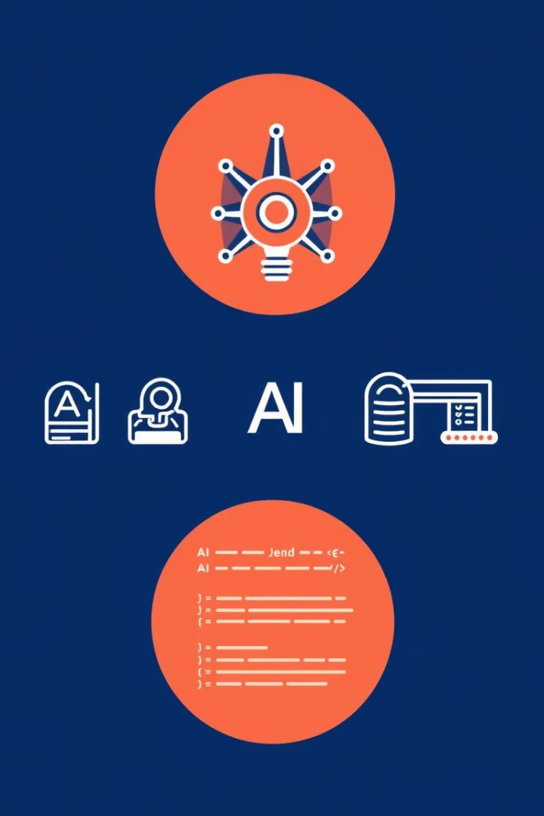
Behind the Scenes – Tech Stack
Frontend
HTML, CSS, JavaScript
Backend
Python + Flask
AI
Gemini APIs (Vision + Text)
Agents
Crew AI (Nutritionist, Ingredient Checker)
Scraping
requests + BeautifulSoup
Deployment
Replit / Render

Slide 8

Why This Project Rocks
Fast & Lightweight
Real-World Use
No database means quick, smooth performance
Solves everyday nutrition questions and choices
Scalable & Modular
Smart UX & AI
Easily built in phases with demo-able parts
Advanced AI powers intuitive, helpful interface

Slide 9

Next Steps & Help Needed
Refine prompt design for each core task
Set up Crew AI agents effectively
Develop frontend layout and mockups
Test user feedback and iterate

Slide 10

Thank You!
FOOD-SENSEI is more than an app — your food wisdom partner.
Contact us at info@foodsensei.ai | Team FOOD-SENSEI

